Slide 1
Dev Test Labs Overview
Himanshu Desai (Principal Consultant, Readify)

Slide 2
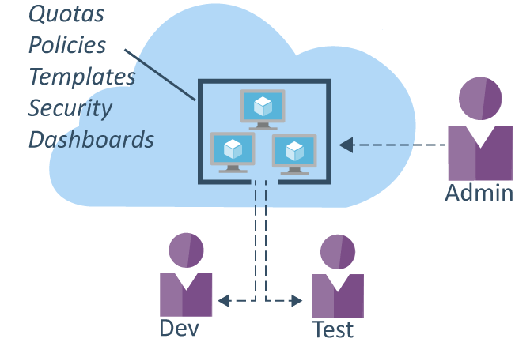

Slide 3
Worry Free Self-Service

Slide 4
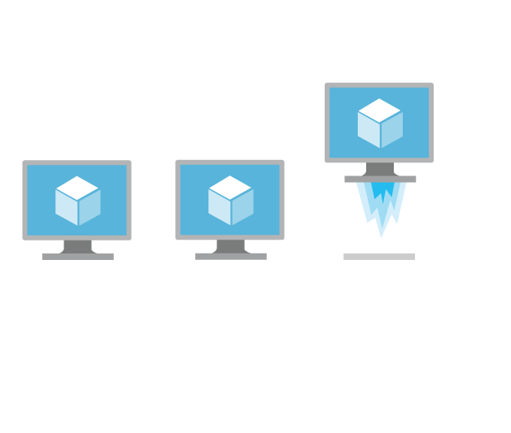
Fast Provisioning

Slide 5
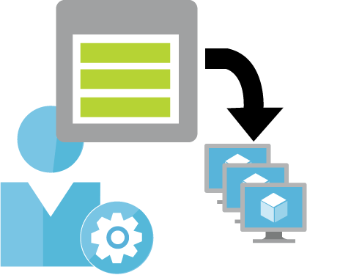
Create Once, Use Everywhere, By Everyone

Slide 6
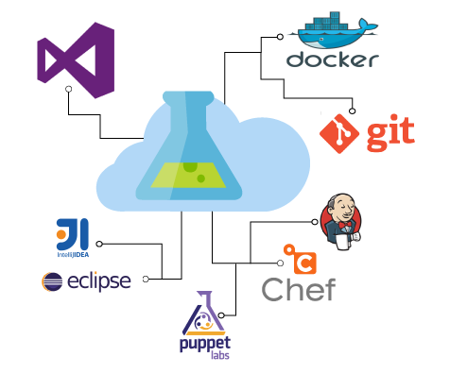
Integrates with your Existing Toolchain

Slide 7
Demo

Slide 8
Questions?

